Slide 1
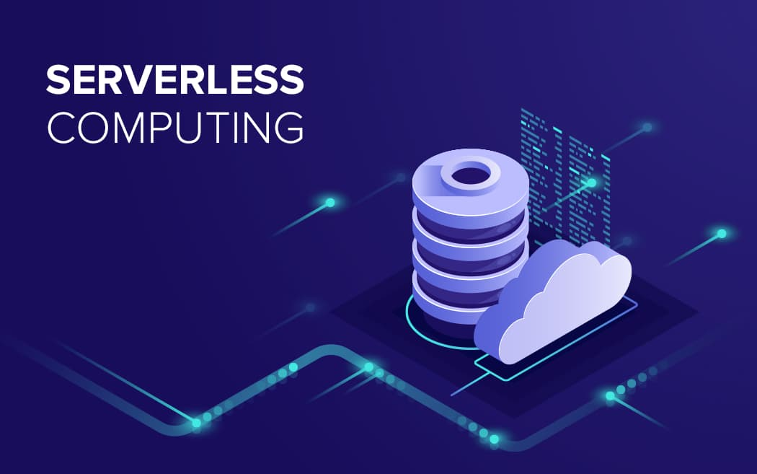
CLOUD COMPUTING PROJECT-2
SERVERLESS
IMAGE
PROCESSING

Slide 2
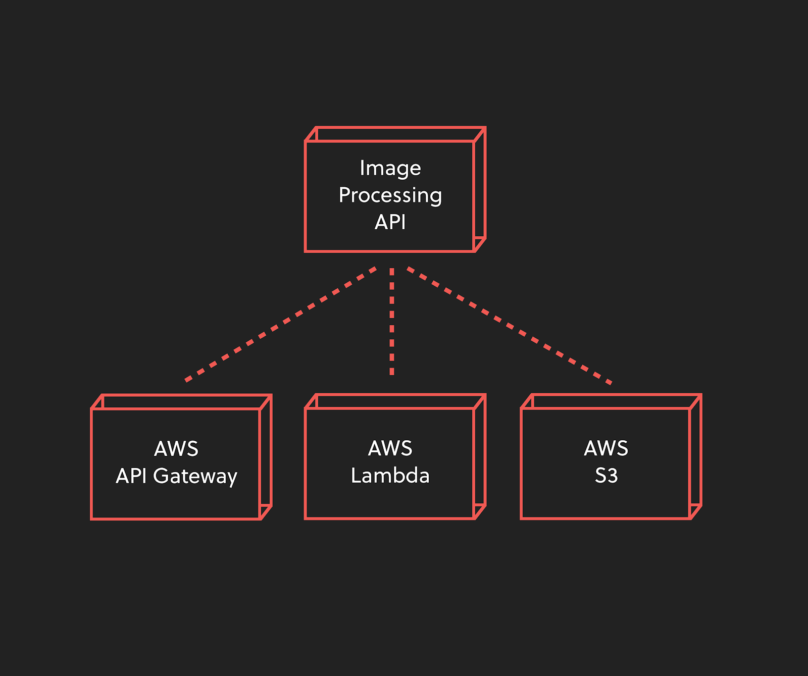

Slide 3

WHAT DO YOU MEAN BY SERVERLESS
Serverless computing is a method of providing backend services on an as-used basis. A serverless provider allows users to write and deploy code without the hassle of worrying about the underlying infrastructure. A company that gets backend services from a serverless vendor is charged based on their computation and do not have to reserve and pay for a fixed amount of bandwidth or number of servers, as the service is auto-scaling. Note that despite the name serverless, physical servers are still used but developers do not need to be aware Of them.
In the early days of the web, anyone who wanted to build a web application had to own the physical hardware required to run a server, which is a cumbersome and expensive undertaking.

Slide 4
What are the advantages of serverless computing?
Lower costs - Serverless computing is generally very cost-effective, as traditional cloud providers of backend services (server allocation) often result in the user paying for unused space or idle CPU time.
Simplified scalability - Developers using serverless architecture don’t have to worry about policies to scale up their code. The serverless vendor handles all of the scaling on demand.
Simplified backend code - With FaaS, developers can create simple functions that independently perform a single purpose, like making an API call.
Quicker turnaround - Serverless architecture can significantly cut time to market. Instead of needing a complicated deploy process to roll out bug fixes and new features, developers can add and modify code on a piecemeal basis.

Slide 5
WHAT THINGS NEED TO MAKE SERVERLESS IMAGE PROCESSING
1-- CREAT TWO BUCKT
2-- LAMBDA FUNVTION
3-- CREAT ROLE

Slide 6
WHAT IS BUCKET ?
Buckets are the basic containers that hold your data. Everything that you store in Cloud Storage must be contained in a bucket. You can use buckets to organize your data and control access to your data, but unlike directories and folders, you cannot nest buckets
There is no limit to the number of buckets you can have in a project or location.
There are, however, limits to the rate you can create or delete buckets.
When you create a bucket, you give it a globally-unique name and a geographic location where the bucket and its contents are stored
.
You cannot change the name or location of an existing bucket. Instead, you can create a new bucket with the desired name or in the desired location and move the contents from the old bucket to the new bucket. See Moving and Renaming Buckets for a step-by-step guide.
Pricing (such as charges for data storage, operations, retrieval fees, and network egress) depends on factors such as the location and storage class of your bucket. For more details, see Cloud Storage pricing.

Slide 7
WHAT IS LAMBDA ?
AWS Lambda is a compute service that lets you run code without provisioning or managing servers.
Lambda runs your code on a high-availability compute infrastructure and performs all of the administration of the compute resources, including server and operating system maintenance, capacity provisioning and automatic scaling, and logging. With Lambda, all you need to do is supply your code in one of the language runtimes that Lambda supports.
You organize your code into Lambda functions. The Lambda service runs your function only when needed and scales automatically. You only pay for the compute time that you consume—there is no charge when your code is not running. For more information,

Slide 8
When to use Lambda
File processing: Use Amazon Simple Storage Service (Amazon S3) to trigger Lambda data processing in real time after an upload.
Stream processing: Use Lambda and Amazon Kinesis to process real-time streaming data for application activity tracking, transaction order processing, clickstream analysis, data cleansing, log filtering, indexing, social media analysis, Internet of Things (IoT) device data telemetry, and metering.
Web applications: Combine Lambda with other AWS services to build powerful web applications that automatically scale up and down and run in a highly available configuration across multiple data centers.
IoT backends: Build serverless backends using Lambda to handle web, mobile, IoT, and third-party API requests.
Mobile backends: Build backends using Lambda and Amazon API Gateway to authenticate and process API requests. Use AWS Amplify to easily integrate with your iOS, Android, Web, and React Native frontends.

Slide 9
LAMBDA SUPPORT WHICH LANGUAGE AND RUNTIME
Node.js 8.10
Node.js 10.x (normally the latest LTS version from the 10.x series)
Node.js 12.x (normally the latest LTS version from the 12.x series)
Python 2.7
Python 3.6
Python 3.7
Python 3.8
Ruby 2.5
Java 8 - This includes JVM-based languages that can run on Java 8’s JVM — the latest Clojure 1.10 and Scala 2.12 both run on Java 8 so can be used with AWS Lambda
Java 11
Go 1.x (latest release)

Slide 10
AWS LAMBDA PRICING
$0.20 per 1M requests
The free tier includes 1M requests.
Function memory and run time
$0.0000166667 per GB-second
The free tier includes 400,000 GB-seconds.
Inbound network traffic to the Lambda function
Free
Outbound network traffic—within the same AWS region
$0.01/GB
Outbound network traffic—to public internet $0.009/gb
.Lower pricing per GB applied starting at 10TB/month

Slide 11
Layout of steps
1-Create two buckets and name them as the following: “original-bucket” and “Processed-bucket”(use oregon for your region)
2- upload an image in “original-bucket”.
3- Create a new role and attach s3 and lambda full access : LambdaRole
4- Create Lambda function from scratch, python 3.7 as runtime and use an existing roles
5- (a) Chose upload from S3 and paste the link https://s3-us-west-2.amazonaws.com/us-west-2-aws-training/awsu-spl/spl88/2.3.prod/scripts/CreateThumbnail.zip (b) change the handler name “CreateThumbnail.handler”.
6- Create the test event and modify the json code with your bucket name and the key to your image you just upload, save and test. Go and upload a second image into “original-bucket” and it will automatically be resized and moved to “processed-bucket”

Slide 12
Some steps follow and creat a serverless image processing
Lab Steps
Task 1: Sign in to AWS Management Console
Click on the Open Console button, and you will get redirected to AWS Console in a new browser tab.
On the AWS sign-in page,
Leave the Account ID as default. Never edit/remove the 12 digit Account ID present in the AWS Console. otherwise, you cannot proceed with the lab.
Now copy your User Name and Password in the Lab Console to the IAM Username and Password in AWS Console and click on the Sign in button
Once Signed In to the AWS Management Console, Make the default AWS Region as US East (N. Virginia) us-east-1.
Task 2: Create Two Amazon S3 Buckets
In this task, we will create two AWS S3 buckets i.e the source bucket and the destination bucket by providing the required configurations like name, region etc.
Navigate to the Services menu in the top, then click on S3 in the Storage section.
Click on Create Bucket button.

Slide 13
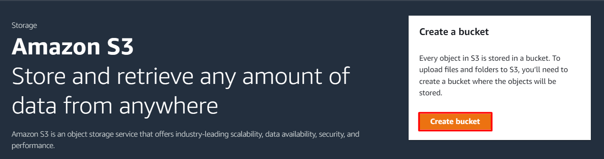
3. Bucket Name: Enter mysourcebucket12345
Note: Every S3 bucket name is unique globally, so create the bucket with a name not currently in use.
4. AWS Region: Select US East (N. Virginia) us-east-1

Slide 14
3. Bucket Name: Enter mysourcebucket12345 Note: Every S3 bucket name is unique globally, so create the bucket with a name not currently in use. 4. AWS Region: Select US East (N. Virginia) us-east-1 5.Leave other settings as default and click on the Create bucket button. 6. Once the bucket is created successfully, Select your S3 bucket. Click on the Copy ARN button to copy the ARN .Save the source bucket ARN in a text file for later use arn:aws:s3:::mysourcebucket12345 7. Create Destination Bucket Click on Create bucket button. Bucket Name: Enter mydestinationbucket12345 Note: Every S3 bucket name is unique globally, so create the bucket with a name not currently in use. AWS Region: Select US East (N. Virginia) us-east-1 Leave other settings as default and click on the Create bucket button. 8. Once the bucket is created successfully, Select your S3 bucket. Click on the Copy ARN button to copy the ARN. Save the destination bucket ARN in a text file for later use. arn:aws:s3:::mydestinationbucket12345 Now we have two S3 buckets (Source and Destination). We will make use of our AWS Lambda function to copy the content from source bucket to destination bucket.

Slide 15
Task 3: Create an IAM Policy 1.As a pre-requisite for creating the Lambda function, we need to create a user role with a custom policy. 2.Go to Services and Select IAM under Security, Identity and Compliance . 3.Click on Policies in the left navigation bar and click on the Create policy button 4. Click on the JSON tab, Remove the existing code and copy-paste the below policy statement into the editor Replace the Source and destination ARN name of the bucket (which you have saved before) in the option Resource. Make sure to add /* at the end of the ARN name . Leave everything as default and click on Next button. On the Review Policy Page: Policy Name: Enter mypolicy Click on the Create policy button. 5 .An IAM Policy with the name mypolicy is created.

Slide 16
Task 4: Create an IAM Role 1 .In the left menu, click on Roles. Click on the Create role button. 2 . Select Lambda from AWS Services list. .From Trusted Entity Type: Select AWS Service .From Use case: Select Lambda . Click on Next button. . Filter Policies: Now you can see a list of policies. Here you have to select two policies: mypolicy and AWSLambdaBasicExecutionRole Select your policy and click on the Next button. Role Name: Enter myrole Click on the Create Role button

Slide 17
Task 5: Create a Lambda Function .Make sure you are in the US East (N. Virginia) region .Go to the Services menu and click on Lambda under Compute section. . .Click on the Create a function button. .Choose Author from scratch .Function name : Enter mylambdafunction . Runtime : Select Node.js 16x Role: In the permissions section, click on Change default execution role and then select Use an existing role . Existing role: Select myrole from the list Click on the Create function button. .If you scroll down a little bit, you can see the Code source section. Here we need to write a NodeJs function that copies the object from the source bucket and paste it into the destination bucket. .Remove the existing code in AWS lambda index.js. Copy the below code and paste it into your lambda index.js file. .You need to change the source and destination bucket name in the index.js file line number 5 & 6 based on your bucket names. Save the function by clicking on Deploy button.

Slide 18
Task 6: Adding Triggers to Lambda Function 1. Scroll up to go to Function overview and click on + Add trigger button. 2. Scroll down the list and select S3 from the trigger list. Once you select S3, a form will appear. Enter these detail : Bucket: Select your source bucket - mysourcebucket12345 . Event type: Select All object create events . Leave other fields as default. And check this option of Recursive invocation to avoid failures in case you upload multiple files at once . and Check the acknowledged option. . Click on Add button.

Slide 19
Task 7: Test Lambda function .If you have a test image on your local machine, you can use that image. .Click on Download Me to open the image in new tab, right click the image and save it to your local. .Go to S3 Bucket list and click on source bucket - mysourcebucket12345. .Upload image to source S3 bucket. To do that: .Click on the Upload button. .Click on Add files button to add the files. .Select the image and click on the Upload to upload the image. .Now go back to the S3 list and open your destination bucket - mydestinationbucket12345. You can see a copy of your uploaded source bucket image in the destination bucket.

Slide 20

THE END OF PRESENTATION PROJECT
THANK
YOU

